Slide 1


Event Management System
Depi Project
Supervised by: Eng.Eslam Ghanem
Notes:
1

Slide 2

Team members
Alexandra Raees
Aya Khaled
Notes:
2

Slide 3




Table of Content
1
Events Problem
5
Implementation
2
Main Functions
6
Future Work
3
Diagrams
Project Tools
4
Notes:
6

Slide 4
Events Problem
Managing events, ticket sales, and vendors is often complicated.
Current platforms don’t connect registration, vendors, and analytics smoothly.
Problems include:
-Fake tickets
-Slow payments
-Poor scalability for large events
These issues make organizing events harder.
Notes:
3

Slide 5
Project Main Functions
Know Event Management
Users knew what website provide
Event Creation & Management
Organizers can create, update and manage event details
Real-Time Analytics
Shows live data
Notes:
4

Slide 6
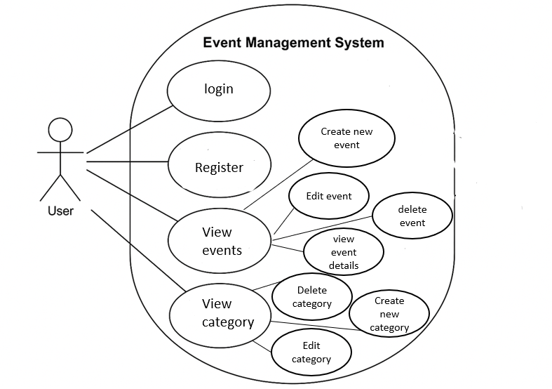
Use Case Diagram
Notes:
8

Slide 7






Project Tools
Notes:
5

Slide 8
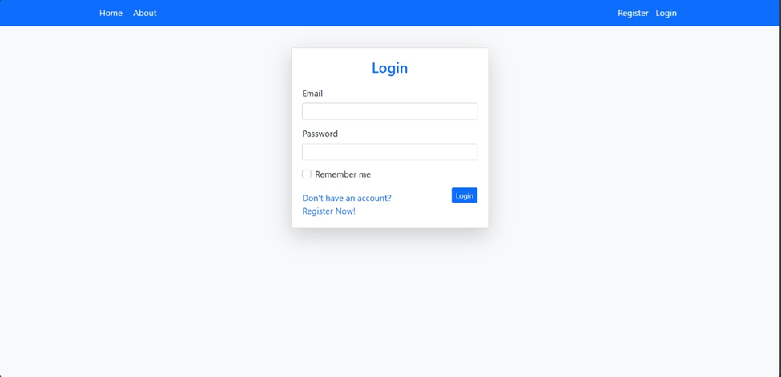
Implementation
Notes:
9

Slide 9
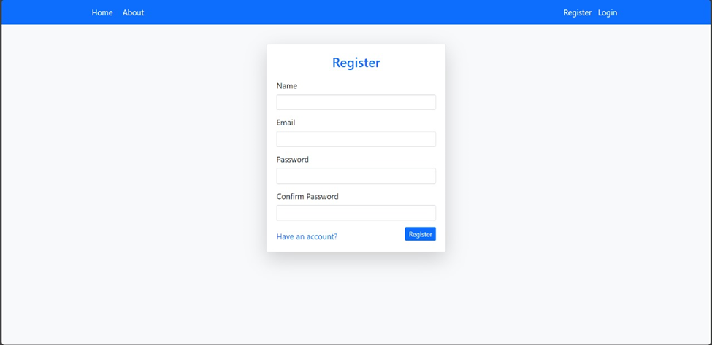
Implementation
Notes:
9

Slide 10
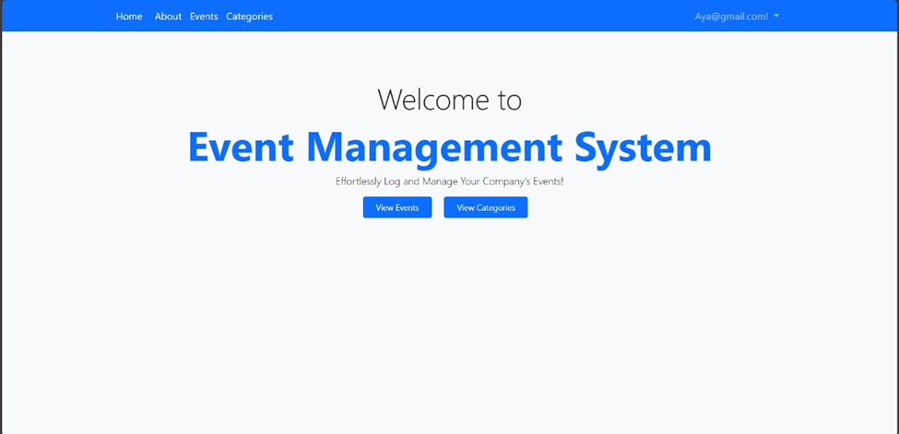
Implementation
Notes:
9

Slide 11
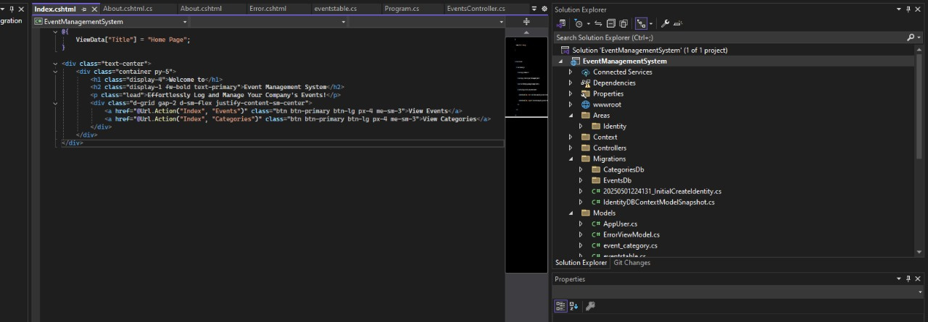
Implementation
Notes:
9

Slide 12
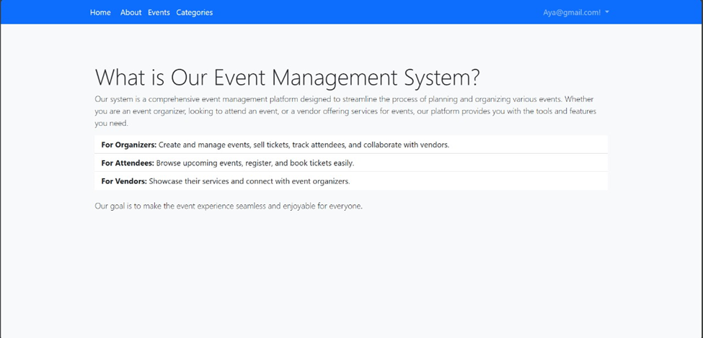
Implementation
Notes:
9

Slide 13
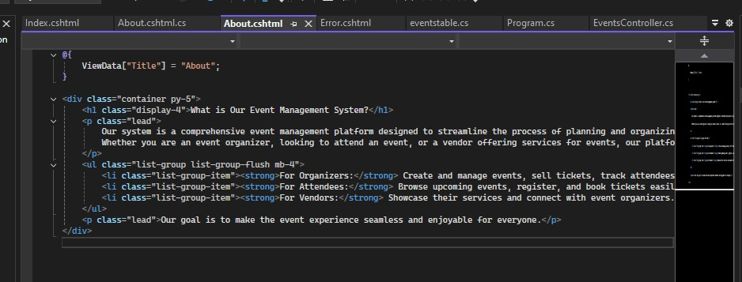
Implementation
Notes:
9

Slide 14
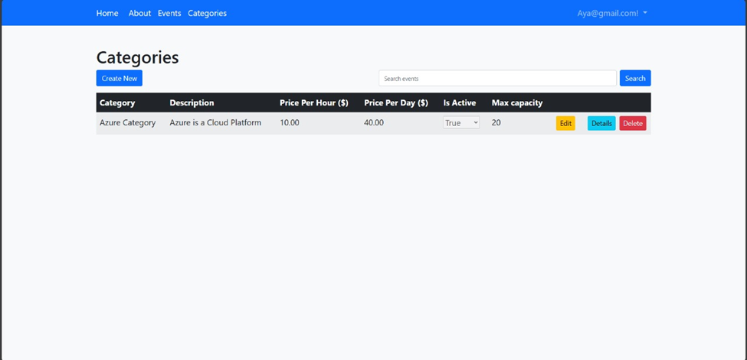
Implementation
Notes:
9

Slide 15
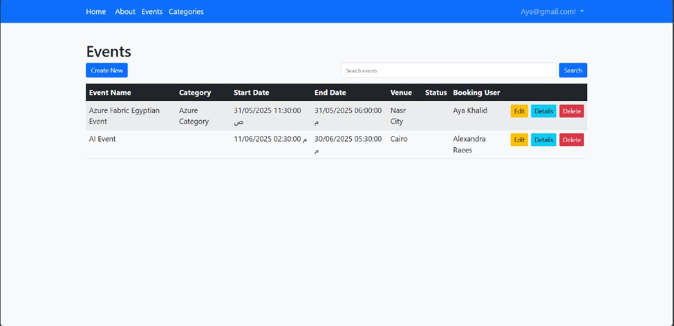
Implementation
Notes:
9

Slide 16
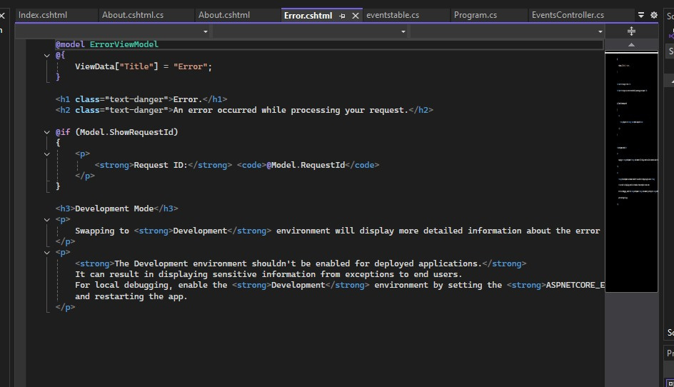
Implementation
Notes:
9

Slide 17
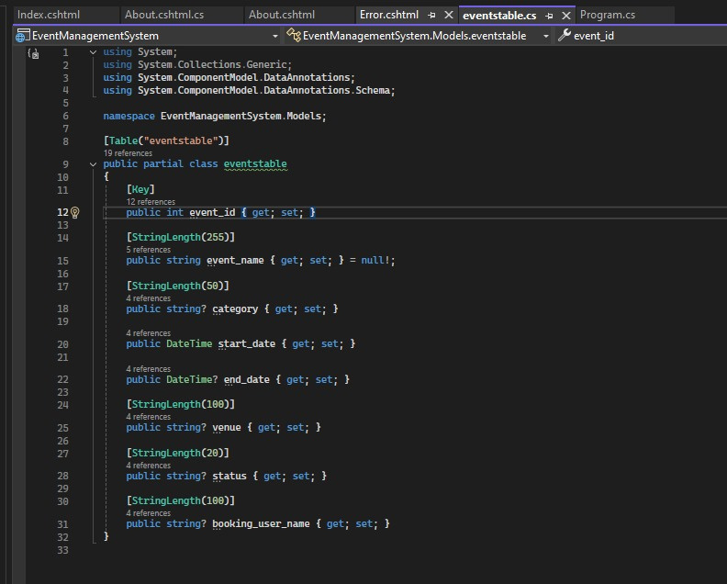
Implementation
Notes:
9

Slide 18
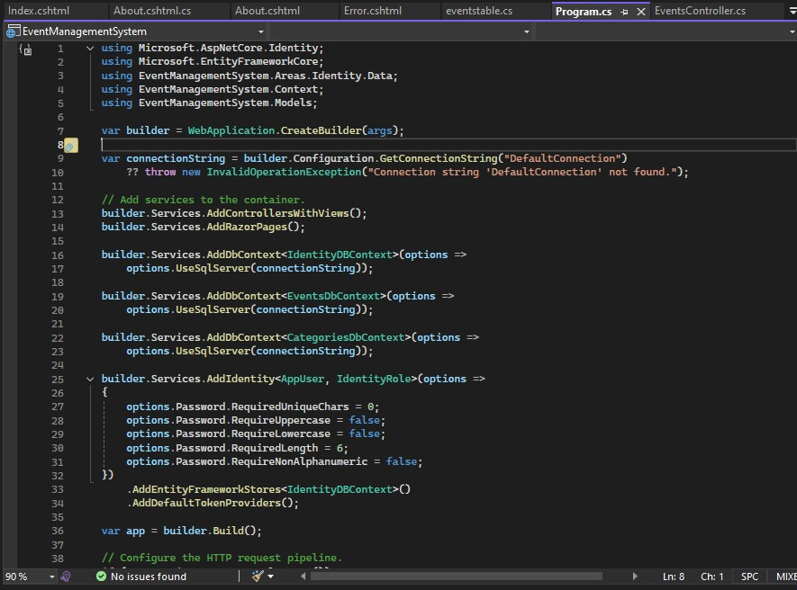
Implementation
Notes:
9

Slide 19
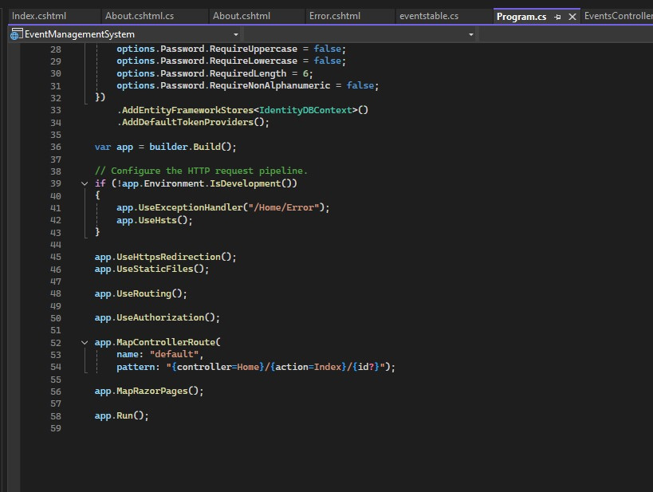
Implementation
Notes:
9

Slide 20
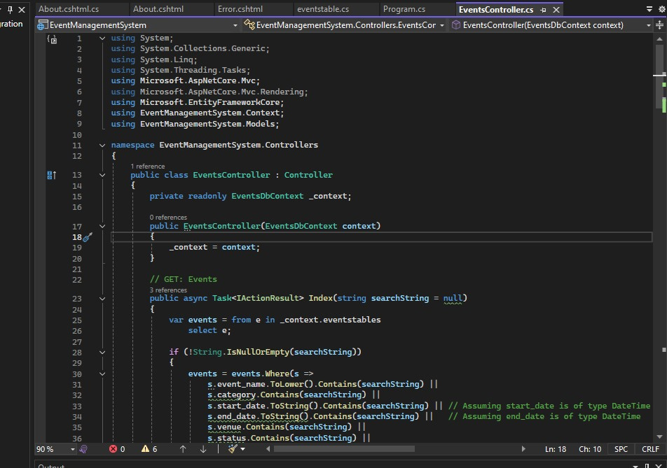
Implementation
Notes:
9

Slide 21
Future Work
Booking Tickets
Payment Services Integration
Notes:
7

Slide 22
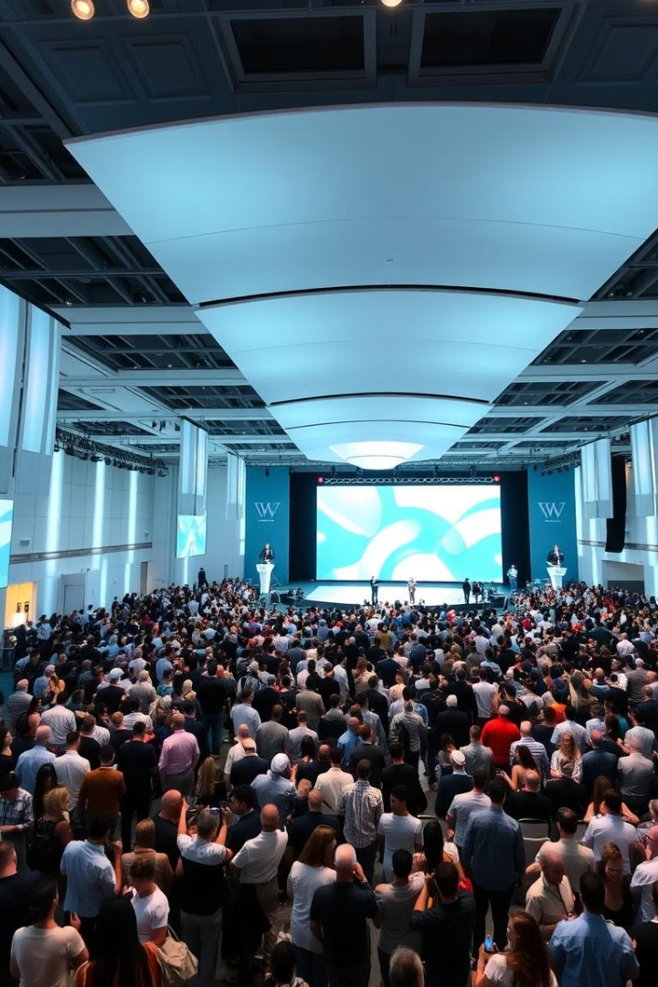
Thank
You
Notes:
7

